Slide 1
Arabesque: A System for Distributed Graph Mining
Discussion
Baran Kaya
Notes:
Relational data
Cleaning, change management – crowd sourcing
First different data storing format

Slide 2
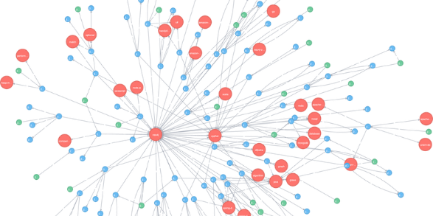
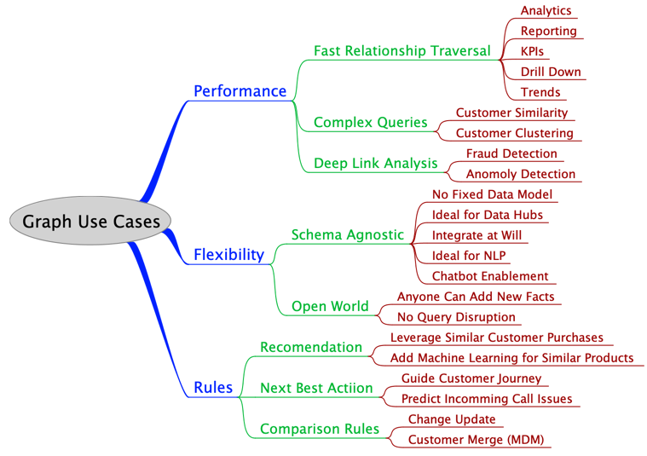
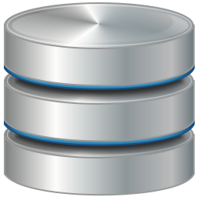
Question 1
Graph data & mining
Relational data vs Graph data
Individual data vs path/relation
Social media, biology & networks
Supply chain management, e-commerce recommendations, security, fraud detection, utility power grid scheduling, knowledge graph for AI applications, analytical queries on blockchain general ledger data
Notes:
When should we choose?
Do you have any project?
Have you ever used it?
Hierarchy
Fast relational traversal queries
Perf: More tuples VS More relations

Slide 3
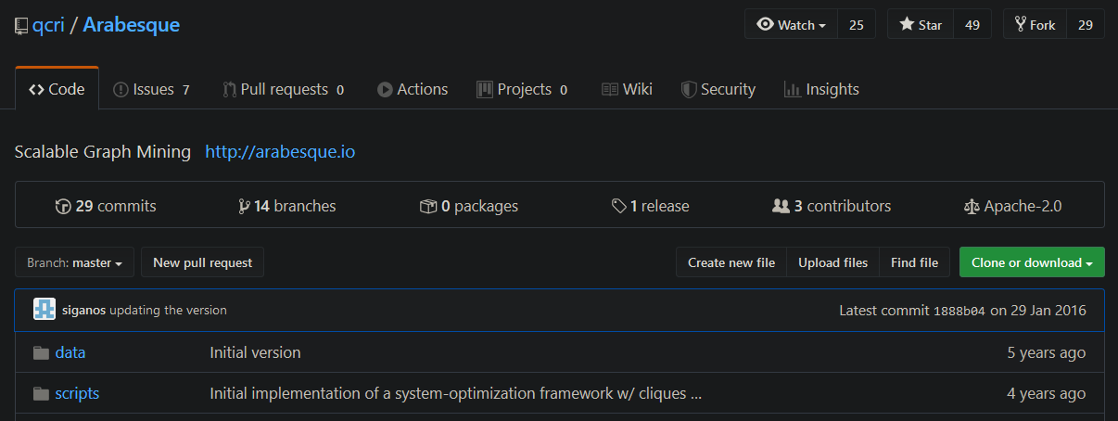
Question 2
Arabesque popularity?
112 citations (2015)
Notes:
Decent
Focuses only specific problems?

Slide 4
Question 3
Best or most useful performance improvement methods/features?
Filtering then processing
Distributed system with workers
Optional aggregation functions
Embedding canonicality (for automorphism)
Think like an embedding (Create instances when needed)
It is a system = Less coding
Using ODAG
Worker load balancing (round robin on large blocks of b embeddings)
Two-level pattern aggregation (for isomorphism)
Notes:
TLE=The key difference between TLP and the embedding-centric view of the filter-process model is that it is not necessary to explicitly materialize all embeddings: state can be kept at the granularity of patterns (which are much fewer than embeddings) and embeddings may be re-generated on demand

Slide 5
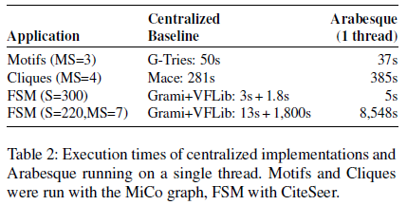
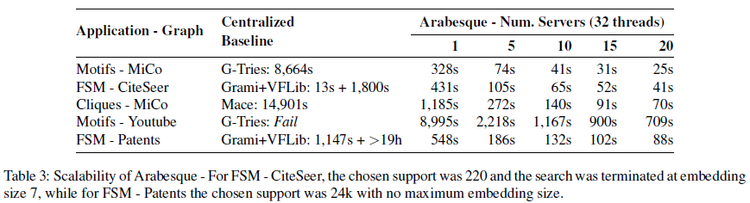
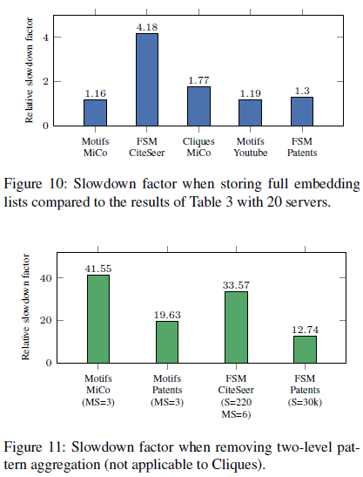
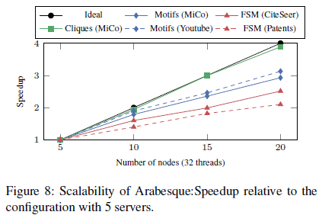
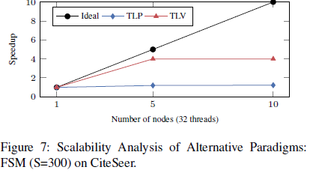
TLE-TLV-TLP
Scalability
ODAG
Single thread performance
Aggregation
Scalability

Slide 6
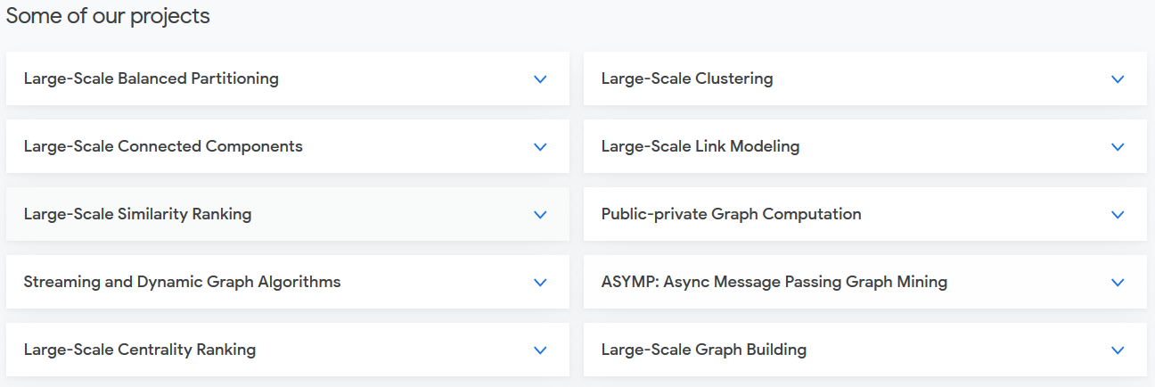
Question 4
Arabesque in other graph mining problems
Graph data cleaning?
Notes:
Do you have any experience on graph data mining?

Slide 7
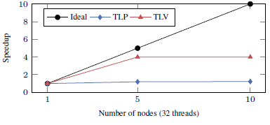
Question 5
TLV vs TLP vs TLE
TLV →120M messages exchange, 300 seconds
Arabesque →137K messages exchange, 7 seconds
TLP → 3 seconds, not scalable
Notes:
TLV=Scalability bottleneck, each embedding needs to be replicated to each vertex that has the necessary local information to expand the embedding further.
In addition, high-degree vertices need to expand a disproportionate fraction of embeddings Due to the hot-spots inherent to the graph structure, or the label distribution, and the extended duplication of state that the TLV paradigm requires
TLP can provide the best performance for a single thread (centralized) scenario, its lack of scalability limits the usefulness in distributed frameworks

Slide 8
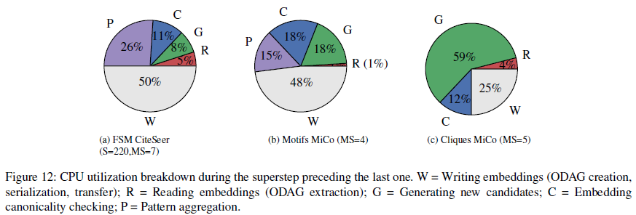
Question 6
Distributed vs Central systems
Single graph vs Multi graphs
Scalability

Slide 9
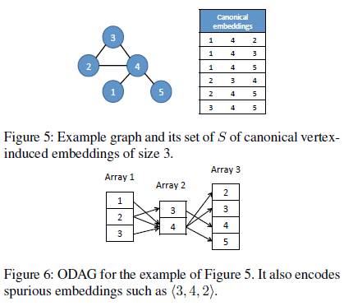
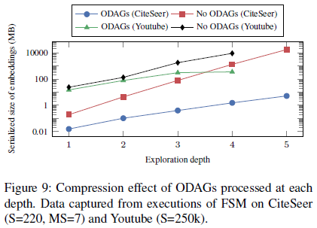
Question 7
Overapproximating Directed Acyclic Graph (ODAG)
“When extracting embeddings from ODAGs we must do extra work to discard spurious paths. ODAGs thus trade space complexity for computational complexity.”
Filter out spurious embeddings → Filter function
Figure 9 shows ODAG performs better but why?

Slide 10
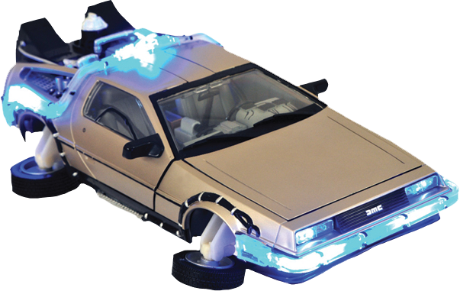

Question 8
Future work
Arabesque system improvements
Instead of Java: C/C++ or Python
Different mining problems

